Slide 1
Basic software development

Slide 2
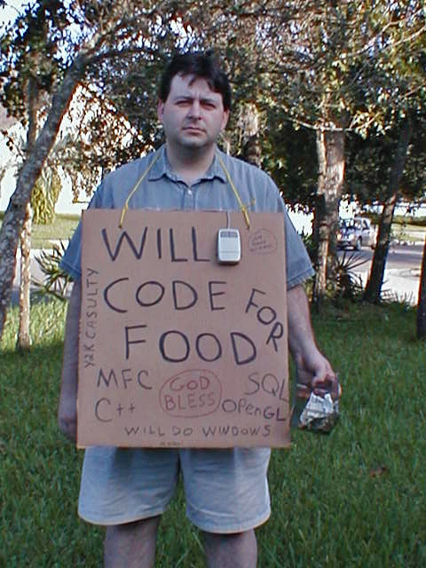
About us
Andrei Apetrei
Răzvan Rădeanu
Radu Șolcă

Slide 3
About YOU

Slide 4
Agenda
Introduction
Classes
class interactions
coupling
inheritance
composition
OOP Pillars
abstraction
encapsulation
inheritance
polymorphism
Interfaces
SOLID Code
Other noteworthy principles

Slide 5
Introduction

Slide 6
Classes
What is a class ?
Notes:
What can be enclosed : The data and behaviors are the members of the class or struct, and they include its methods, properties, and events, and so on.
A data structure that encloses a set of data and behaviors that belong together as a logical unit
Custom type : fields -> any type , including nested class

Slide 7
Classes
Why classes ?
Notes:
What can be enclosed : The data and behaviors are the members of the class or struct, and they include its methods, properties, and events, and so on.
They provide useful abstraction and structure
Custom type : fields -> any type , including nested class
They help you think about the application you are building
Class names are nouns, not verbs
Good: ExpenseClaim, Employee, Printer
Bad: Ordering, Personnel, System ?

Slide 8
Classes
When to use classes ?
Notes:
What can be enclosed : The data and behaviors are the members of the class or struct, and they include its methods, properties, and events, and so on.
When we want to achieve the structure and grouping of common data and methods that we need.

Slide 9
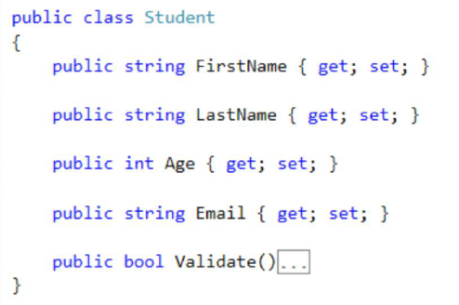
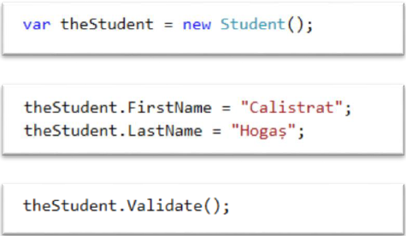
Classes
Class vs. object
CLASS = code OBJECT=instance of a class
Notes:
When an object of the class is created, the variable to which the object is assigned holds only a reference to that memory. When the object reference is assigned to a new variable, the new variable refers to the original object. Changes made through one variable are reflected in the other variable because they both refer to the same data.
The variable remains in memory until all references to it go out of scope. At that time, the CLR marks it as eligible for garbage collection

Slide 10
Classes
Class members overview
Notes:
Destructor, operatori, index

Slide 11
Classes
Class members overview
Fields
Notes:
Fields are variables declared at class scope. A field may be a built-in numeric type or an instance of another class. For example, a calendar class may have a field that contains the current date.

Slide 12
Classes
Class members overview
Fields
Constants
Notes:
ConstantsConstants are fields or properties whose value is set at compile time and cannot be changed.

Slide 13
Classes
Class members overview
Fields
Constants
Properties
Notes:
PropertiesProperties are methods on a class that are accessed as if they were fields on that class. A property can provide protection for a class field to keep it from being changed without the knowledge of the object.

Slide 14
Classes
Class members overview
Fields
Constants
Properties
Methods
Notes:
MethodsMethods define the actions that a class can perform. Methods can take parameters that provide input data, and can return output data through parameters. Methods can also return a value directly, without using a parameter.

Slide 15
Classes
Class members overview
Fields
Constants
Properties
Methods
Constructors
Notes:
ConstructorsConstructors are methods that are called when the object is first created. They are often used to initialize the data of an object.

Slide 16
Classes
Class members overview
Fields
Constants
Properties
Methods
Constructors
Events
Notes:
EventsEvents provide notifications about occurrences, such as button clicks or the successful completion of a method, to other objects. Events are defined and triggered by using delegates.

Slide 17
Classes
Class members overview
Fields
Constants
Properties
Methods
Constructors
Events
Finalizers
Notes:
FinalizersFinalizers are used very rarely in C#. They are methods that are called by the runtime execution engine when the object is about to be removed from memory. They are generally used to make sure that any resources which must be released are handled appropriately

Slide 18
Classes
Class members overview
Fields
Constants
Properties
Methods
Constructors
Events
Finalizers
Indexers
Notes:
IndexersIndexers enable an object to be indexed in a manner similar to arrays.
.

Slide 19
Classes
Class members overview
Fields
Constants
Properties
Methods
Constructors
Events
Finalizers
Indexers
Operator
Notes:
OperatorsOverloaded operators are considered class members. When you overload an operator, you define it as a public static method in a class. The predefined operators (+, *, <, and so on) are not considered members. For more information, see Overloadable Operators.

Slide 20
Classes
Class members overview
Fields
Constants
Properties
Methods
Constructors
Events
Finalizers
Indexers
Operator
Nested Types
Notes:
Nested TypesNested types are types declared within another type. Nested types are often used to describe objects that are used only by the types that contain them.

Slide 21
Classes
Static classes
Notes:
A static class is basically the same as a non-static class, but there is one difference: a static class cannot be instantiated. In other words, you cannot use the new keyword to create a variable of the class type

Slide 22
Classes
Static classes
Cannot be instantiated
Notes:
A static class is basically the same as a non-static class, but there is one difference: a static class cannot be instantiated. In other words, you cannot use the new keyword to create a variable of the class type
Because there is no instance variable, you access the members of a static class by using the class name itself
For example, if you have a static class that is named UtilityClass that has a public method named MethodA, you call the method.
For example, in the .NET Framework Class Library, the static System.Math class contains methods that perform mathematical operations, without any requirement to store or retrieve data that is unique to a particular instance of the Math class. That is, you apply the members of the class by specifying the class name and the method name, as shown in the following example.

Slide 23
Classes
Static classes
Cannot be instantiated
Contains only static members.
Notes:
A static class is basically the same as a non-static class, but there is one difference: a static class cannot be instantiated. In other words, you cannot use the new keyword to create a variable of the class type
Because there is no instance variable, you access the members of a static class by using the class name itself
For example, if you have a static class that is named UtilityClass that has a public method named MethodA, you call the method.
For example, in the .NET Framework Class Library, the static System.Math class contains methods that perform mathematical operations, without any requirement to store or retrieve data that is unique to a particular instance of the Math class. That is, you apply the members of the class by specifying the class name and the method name, as shown in the following example.
Creating a static class is therefore basically the same as creating a class that contains only static members and a private constructor. A private constructor prevents the class from being instantiated. The advantage of using a static class is that the compiler can check to make sure that no instance members are accidentally added. The compiler will guarantee that instances of this class cannot be created
Static classes are sealed and therefore cannot be inherited. They cannot inherit from any class except Object. Static classes cannot contain an instance constructor; however, they can contain a static constructor. Non-static classes should also define a static constructor if the class contains static members that require non-trivial initialization.

Slide 24
Classes
Static classes
Cannot be instantiated
Contains only static members.
Are sealed
Notes:
Creating a static class is therefore basically the same as creating a class that contains only static members and a private constructor. A private constructor prevents the class from being instantiated. The advantage of using a static class is that the compiler can check to make sure that no instance members are accidentally added. The compiler will guarantee that instances of this class cannot be created
Static classes are sealed and therefore cannot be inherited.
They cannot inherit from any class except Object.
Static classes cannot contain an instance constructor;
however, they can contain a static constructor.
Non-static classes should also define a static constructor if the class contains static members that require non-trivial initialization.

Slide 25
Classes
Static classes
Cannot be instantiated
Contains only static members
Are sealed
Cannot contain Instance Constructors
Notes:
Creating a static class is therefore basically the same as creating a class that contains only static members and a private constructor. A private constructor prevents the class from being instantiated. The advantage of using a static class is that the compiler can check to make sure that no instance members are accidentally added. The compiler will guarantee that instances of this class cannot be created
Static classes are sealed and therefore cannot be inherited.
They cannot inherit from any class except Object.
Static classes cannot contain an instance constructor;
however, they can contain a static constructor.
Non-static classes should also define a static constructor if the class contains static members that require non-trivial initialization.

Slide 26
Classes
Constructors
Notes:
Whenever a class or struct is created, its constructor is called. A class or struct may have multiple constructors that take different arguments. Constructors enable the programmer to set default values, limit instantiation, and write code that is flexible and easy to read.

Slide 27
Classes
Constructors
Default constructors
Notes:
If you don't provide a constructor for your class, C# creates one by default that instantiates the object and sets member variables to the default values as listed in the Default Values Table.

Slide 28
Classes
Constructors
Default constructors
Syntax
Notes:
A constructor is a method whose name is the same as the name of its type. Its method signature includes only the method name and its parameter list; it does not include a return type. The following example shows the constructor for a class named Person.

Slide 29
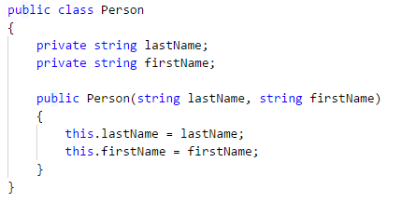
Classes
Constructors
Default constructors
Syntax
Notes:
A constructor is a method whose name is the same as the name of its type. Its method signature includes only the method name and its parameter list; it does not include a return type. The following example shows the constructor for a class named Person.

Slide 30
Classes
Methods

Slide 31
Classes
Methods
Signature

Slide 32
Classes
Methods
Signature
Methods are declared in a class by specifying:

Slide 33
Classes
Methods
Signature
Methods are declared in a class by specifying:
the access level
Notes:
(Method parameters are enclosed in parentheses and are separated by commas; empty parentheses indicate that the method requires no parameters).

Slide 34
Classes
Methods
Signature
Methods are declared in a class by specifying:
the access level
optional modifiers
Notes:
(Method parameters are enclosed in parentheses and are separated by commas; empty parentheses indicate that the method requires no parameters).

Slide 35
Classes
Methods
Signature
Methods are declared in a class by specifying:
the access level
optional modifiers
the return value
Notes:
(Method parameters are enclosed in parentheses and are separated by commas; empty parentheses indicate that the method requires no parameters).

Slide 36
Classes
Methods
Signature
Methods are declared in a class by specifying:
the access level
optional modifiers
the return value
the name of the method
Notes:
(Method parameters are enclosed in parentheses and are separated by commas; empty parentheses indicate that the method requires no parameters).

Slide 37
Classes
Methods
Signature
Methods are declared in a class by specifying:
the access level
optional modifiers
the return value
the name of the method
any method parameters
Notes:
(Method parameters are enclosed in parentheses and are separated by commas; empty parentheses indicate that the method requires no parameters).

Slide 38
Classes
Methods
Signature
Methods are declared in a class by specifying:
the access level
optional modifiers
the return value
the name of the method
any method parameters
These parts together are the signature of the method.
Notes:
(Method parameters are enclosed in parentheses and are separated by commas; empty parentheses indicate that the method requires no parameters).

Slide 39
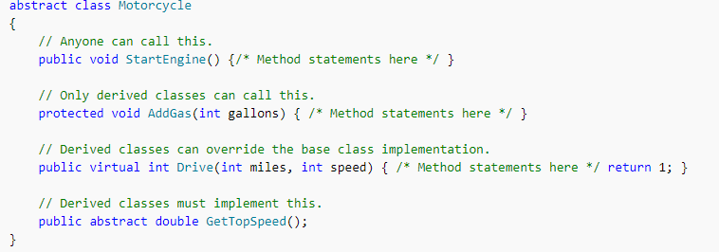
Classes
Methods
Signature

Slide 40
Classes
Method overloading vs. method overriding
What is Method Overloading ?

Slide 41
Classes
Method overloading vs. method overriding
What is Method Overloading ?
Creating multiple methods in a class with same name but different parameters and types is called method overloading

Slide 42
Classes
Method overloading vs. method overriding
Method overloading can be achieved by using following things :

Slide 43
Classes
Method overloading vs. method overriding
Method overloading can be achieved by using following things :
By changing the number of parameters used.

Slide 44
Classes
Method overloading vs. method overriding
Method overloading can be achieved by using following things :
By changing the number of parameters used.
By changing the order of parameters.

Slide 45
Classes
Method overloading vs. method overriding
Method overloading can be achieved by using following things :
By changing the number of parameters used.
By changing the order of parameters.
By using different data types for the parameters.

Slide 46
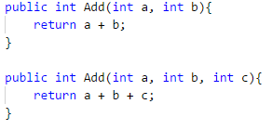
Classes
Method overloading vs. method overriding
Method overloading can be achieved by using following things :
By changing the number of parameters used.
By changing the order of parameters.
By using different data types for the parameters.

Slide 47
Classes
Method overloading vs. method overriding
What is Method overriding ?

Slide 48
Classes
Method overloading vs. method overriding
What is Method overriding ?
Creating a method in a derived class with the same signature.

Slide 49
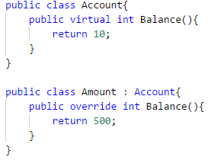
Classes
Method overloading vs. method overriding
What is Method overriding ?
Creating a method in a derived class with the same signature.

Slide 50
Classes
Fields
Notes:
Generally, you should use fields only for variables that have private or protected accessibility. Data that your class exposes to client code should be provided through methods, properties and indexers.
By using these constructs for indirect access to internal fields, you can guard against invalid input values. A private field that stores the data exposed by a public property is called a backing store or backing field.

Slide 51
Classes
Fields
A field is a variable of any type that is declared directly in a class
Notes:
Generally, you should use fields only for variables that have private or protected accessibility. Data that your class exposes to client code should be provided through methods, properties and indexers.
By using these constructs for indirect access to internal fields, you can guard against invalid input values. A private field that stores the data exposed by a public property is called a backing store or backing field.

Slide 52
Classes
Fields
A field is a variable of any type that is declared directly in a class
Fields are declared in the class block by :
Notes:
Generally, you should use fields only for variables that have private or protected accessibility. Data that your class exposes to client code should be provided through methods, properties and indexers.
By using these constructs for indirect access to internal fields, you can guard against invalid input values. A private field that stores the data exposed by a public property is called a backing store or backing field.

Slide 53
Classes
Fields
A field is a variable of any type that is declared directly in a class
Fields are declared in the class block by :
specifying the access level of the field
Notes:
Generally, you should use fields only for variables that have private or protected accessibility. Data that your class exposes to client code should be provided through methods, properties and indexers.
By using these constructs for indirect access to internal fields, you can guard against invalid input values. A private field that stores the data exposed by a public property is called a backing store or backing field.

Slide 54
Classes
Fields
A field is a variable of any type that is declared directly in a class
Fields are declared in the class block by :
specifying the access level of the field
followed by
the type of the field
Notes:
Generally, you should use fields only for variables that have private or protected accessibility. Data that your class exposes to client code should be provided through methods, properties and indexers.
By using these constructs for indirect access to internal fields, you can guard against invalid input values. A private field that stores the data exposed by a public property is called a backing store or backing field.

Slide 55
Classes
Fields
A field is a variable of any type that is declared directly in a class
Fields are declared in the class block by :
specifying the access level of the field
followed by
the type of the field
followed by
the name of the field
Notes:
Generally, you should use fields only for variables that have private or protected accessibility. Data that your class exposes to client code should be provided through methods, properties and indexers.
By using these constructs for indirect access to internal fields, you can guard against invalid input values. A private field that stores the data exposed by a public property is called a backing store or backing field.

Slide 56
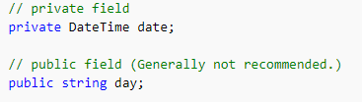
Classes
Fields
A field is a variable of any type that is declared directly in a class
Fields are declared in the class block by :
specifying the access level of the field
followed by
the type of the field
followed by
the name of the field
Notes:
Generally, you should use fields only for variables that have private or protected accessibility. Data that your class exposes to client code should be provided through methods, properties and indexers.
By using these constructs for indirect access to internal fields, you can guard against invalid input values. A private field that stores the data exposed by a public property is called a backing store or backing field.

Slide 57
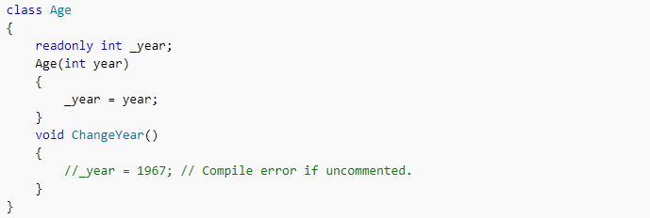
Classes
Fields
A field can be declared readonly. A read-only field can only be assigned a value during initialization or in a constructor

Slide 58
Classes
Access modifiers
Notes:
All types and type members have an accessibility level, which controls whether they can be used from other code in your assembly or other assemblies.

Slide 59
Classes
Access modifiers
Public
Notes:
the type or member can be accessed by any other code in the same assembly or another assembly that references it

Slide 60
Classes
Access modifiers
Public
Private
Notes:
– the type or member can be accessed only by the code in the same class

Slide 61
Classes
Access modifiers
Public
Private
Protected
Notes:
The type or member can be accessed only by code in the same class, or in a class that is derived from that class

Slide 62
Classes
Access modifiers
Public
Private
Protected
Internal
Notes:
- The type or member can be accessed only by code in the same assembly, but not from another assembly

Slide 63
Classes
Access modifiers
Public
Private
Protected
Internal
Protected internal
Notes:
- The type or member can be accessed by any code in the assembly in which it is declared, or from within a derived class in another assembly.

Slide 64
Classes
Access modifiers
Public
Private
Protected
Internal
Protected internal
Private protected
Notes:
The type or member can be accessed only within its declaring assembly, by code in the same class or in a type that is derived from that class.

Slide 65
Classes
Private fields & public accessors vs. public properties

Slide 66
Classes
Private fields & public accessors vs. public properties
Property
Notes:
A property is a member that provides a flexible mechanism to read, write or compute the data of a private field

Slide 67
Classes
Private fields & public accessors vs. public properties
Property
When do you I use a field?
Notes:
Fields should nearly always be private members of a class, so you don’t expose internal implementation.

Slide 68
Classes
Private fields & public accessors vs. public properties
Property
When do you I use a field?
When should I use a property?
Notes:
In general you should use properties if you need them to look and behave like a variable.

Slide 69
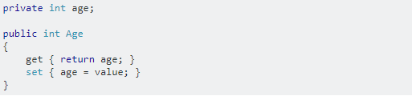
Classes
Private fields & public accessors vs. public properties

Slide 70
Classes
Properties

Slide 71
Classes
Properties
Properties enable a class to expose a public way of getting and setting values, while hiding implementation or verification code.
Notes:
This enables data to be accessed easily and still helps promote the safety and flexibility of methods.

Slide 72
Classes
Properties
Properties enable a class to expose a public way of getting and setting values, while hiding implementation or verification code.
A get property accessor is used to return the property value, and a set property accessor is used to assign a new value.
! These accessors can have different access levels
Notes:
This enables data to be accessed easily and still helps promote the safety and flexibility of methods.

Slide 73
Classes
Properties
Properties can be:
Notes:
This enables data to be accessed easily and still helps promote the safety and flexibility of methods.

Slide 74
Classes
Properties
Properties can be:
read-write (they have both a get and a set accessor)
Notes:
This enables data to be accessed easily and still helps promote the safety and flexibility of methods.

Slide 75
Classes
Properties
Properties can be:
read-write (they have both a get and a set accessor)
read-only (they have a get accessor but no set accessor)
Notes:
This enables data to be accessed easily and still helps promote the safety and flexibility of methods.

Slide 76
Classes
Properties
Properties can be:
read-write (they have both a get and a set accessor)
read-only (they have a get accessor but no set accessor)
write-only (they have a set accessor, but no get accessor).
Notes:
This enables data to be accessed easily and still helps promote the safety and flexibility of methods.
Write-only properties are rare and are most commonly used to restrict access to sensitive data.

Slide 77
Classes
Let’s try something
Notes:
This enables data to be accessed easily and still helps promote the safety and flexibility of methods.
Write-only properties are rare and are most commonly used to restrict access to sensitive data.

Slide 78
Classes
Let’s try something
Să gestioneze cursurile care pot fi teoretice, seminarii sau laboratoare.Sistemul trebuie să permită definirea numelui cursului, numelui profesorului.
Trebuie să permită gestionarea Studenților.Ne intereseză să putem vedea Numele, Adresa de domiciliu, Adresa Curentă, Adresa de email și data nașterii
Trebuie să permită introducerea în sistem a examenelor. Examenele trebuie să aibă în evidență cursul, data examenului și lista de studenți carea au participat cu nota obținută.
Notes:
Course
•Title
•Professor Name
Student
•Name
•Address
•Email
•Average Mark
Exam
•Course
•Exam date
•Room Name
•Results
Exam Result
•Student
•Mark

Slide 79
Class INTERACTIONS
Notes:
This enables data to be accessed easily and still helps promote the safety and flexibility of methods.

Slide 80
Class INTERACTIONS
Class coupling
Notes:
This enables data to be accessed easily and still helps promote the safety and flexibility of methods.

Slide 81
Class INTERACTIONS
Class coupling
Class coupling is a measure on how one class is connected or dependent with another class.
Notes:
This enables data to be accessed easily and still helps promote the safety and flexibility of methods.
Changing one object in a tightly coupled application often requires changes to a number of other objects
In a small application we can easily identify the changes and there is less chance to miss anything.
But in large applications these inter-dependencies are not always known by every programmer or there is a chance of overlooking changes
Tightly Coupled Objects are objects that need to know quite a bit about other objects and are usually highly dependent on each other's interfaces.
LOOSE:
Loose coupling is a much more generic concept intended to increase the flexibility of a system, make it more maintainable, and makes the entire framework more "stable".
Loose coupling is a design goal that seeks to reduce the inter-dependencies between components of a system with the goal of reducing the risk that changes in one component will require changes in any other component

Slide 82
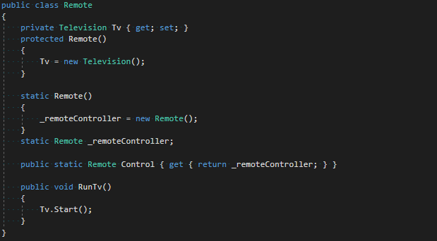
Class INTERACTIONS
Class coupling
Notes:
Tight Coupling creates some difficulties.
Here, the task of the control object, the object needs to be able to television, the television remote control is dependent on the other phrase.
So, what's the harm of the following dependencies:
TV without a remote control does not work.
TV changes the control directly affected by this change.
The Control can only control the TV, cannot control other devices.

Slide 83
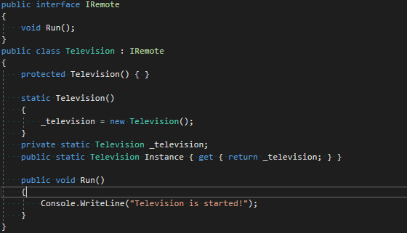
Class INTERACTIONS
Class coupling
Notes:
Loose coupling is a much more generic concept intended to increase the flexibility of a system, make it more maintainable, and makes the entire framework more "stable".

Slide 84
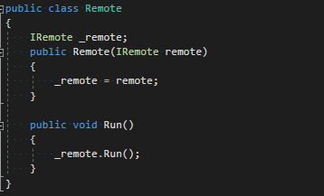
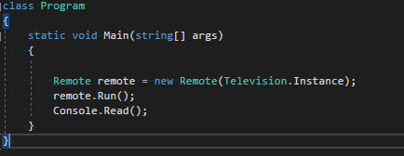
Class INTERACTIONS
Class coupling
Notes:
Loose coupling is a much more generic concept intended to increase the flexibility of a system, make it more maintainable, and makes the entire framework more "stable".

Slide 85

Class INTERACTIONS
Class coupling
Day to day example
Notes:
Loose coupling is a much more generic concept intended to increase the flexibility of a system, make it more maintainable, and makes the entire framework more "stable".
The Hat is "loosely coupled" to the body.
This means you can easily take the hat off
without making any changes to the the
person/body.
When you can do that then you have
"loose coupling.
Think of your skin. It's stuck to your body.
It fits like a glove. But what if you wanted
to change your skin colour from say white
to black?
In other words, if you want to change the
skin, you would also HAVE TO change the
design of your body as well because the two
are joined together - they are tightly coupled.

Slide 86
Class INTERACTIONS
Inheritance (an “Is a” relationship)
Notes:
Loose coupling is a much more generic concept intended to increase the flexibility of a system, make it more maintainable, and makes the entire framework more "stable".

Slide 87
Class INTERACTIONS
Inheritance (an “Is a” relationship)
Inheritance enables you to create new classes that reuse, extend, and modify the behavior that is defined in other classes.
Notes:
Loose coupling is a much more generic concept intended to increase the flexibility of a system, make it more maintainable, and makes the entire framework more "stable".

Slide 88
Class INTERACTIONS
Inheritance (an “Is a” relationship)
Inheritance enables you to create new classes that reuse, extend, and modify the behavior that is defined in other classes.
Base class
Notes:
Loose coupling is a much more generic concept intended to increase the flexibility of a system, make it more maintainable, and makes the entire framework more "stable".
Base class – the class whose members are inherited

Slide 89
Class INTERACTIONS
Inheritance (an “Is a” relationship)
Inheritance enables you to create new classes that reuse, extend, and modify the behavior that is defined in other classes.
Base class
Derived class
Notes:
If ClassC is derived from ClassB, and ClassB is derived from ClassA, ClassC inherits the members declared in ClassB and ClassA.
Note
Derived class
- the class that inherits the members of the base class
- can only have one direct base class

Slide 90
Class INTERACTIONS
Inheritance (an “Is a” relationship)
Inheritance enables you to create new classes that reuse, extend, and modify the behavior that is defined in other classes.
Base class
Derived class
Inheritance is transitive
Notes:
If ClassC is derived from ClassB, and ClassB is derived from ClassA, ClassC inherits the members declared in ClassB and ClassA.

Slide 91
Class INTERACTIONS
Inheritance (an “Is a” relationship)
Real life example : Car is an Automobile.

Slide 92
Class INTERACTIONS
Composition (an “has a” relationship)

Slide 93
Class INTERACTIONS
Composition (an “has a” relationship)
Object composition is a way to combine simple objects or data types into more complex ones.

Slide 94
Class INTERACTIONS
Composition (an “has a” relationship)
Object composition is a way to combine simple objects or data types into more complex ones.
Real life example : A car has an engine.

Slide 95
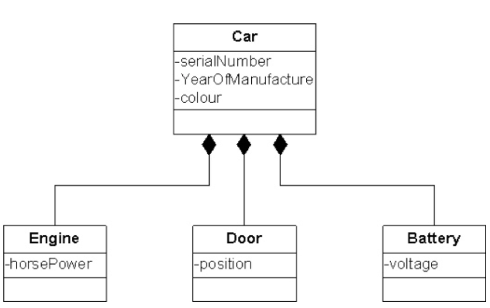
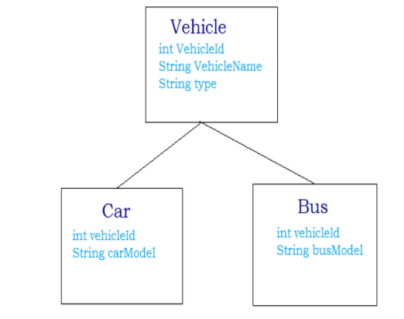
Class INTERACTIONS
Inheritance vs. Composition
Diagrams

Slide 96
Class INTERACTIONS
Class coupling conclusions
Inheritance leads to tight coupling
Composition offers a loose coupling design
Notes:
( changes in the base class will most likely need to be addressed in the derived class)
( changes in any nested type will not need any extra care)

Slide 97
Class INTERACTIONS
Class coupling conclusions
Inheritance leads to tight coupling
Composition offers a loose coupling design
Maintainability is an important characteristic of a project.
Loose coupling enables better testability, which leads to good maintainability.
Notes:
Cum testeaza un developer ?

Slide 98
Class INTERACTIONS
What is a unit test ?
Notes:
A unit test is an automated piece of code that invokes a unit of work in the system and then checks a single assumption about the behavior of that unit of work.
A unit of work is a single logical functional use case in the system that can be invoked by some public interface (in most cases). A unit of work can span a single metho1d, a whole class or multiple classes working together to achieve one single logical purpose that can be verified.

Slide 99
Class INTERACTIONS
Let’s try another thing
Notes:
A unit test is an automated piece of code that invokes a unit of work in the system and then checks a single assumption about the behavior of that unit of work.
A unit of work is a single logical functional use case in the system that can be invoked by some public interface (in most cases). A unit of work can span a single metho1d, a whole class or multiple classes working together to achieve one single logical purpose that can be verified.

Slide 100
OOP Pillars
What do they actually mean
Encapsulation
Abstraction
Inheritance
Polymorphism
Notes:
Cand spunem OOP pillars ne referim de fapt la niste principii ce fundamenteaza OOP-ul asta despre care tot vorbim. Intr-o oarecare masura, nu e o diferenta prea mare intre programarea procedurala si programarea orientata obiect daca nu respectam principiile astea.
Evident, nu sunt altele decat cele despre care ati invatat la facultate sau despre care ati citit pe internet.

Slide 101
Encapsulation
What?
binding data members together
Why?
to protect your object’s integrity
to enforce your intent of hiding unnecessary stuff to the outside world
How?
using classes
Benefits
integrity
defense against invalid state
Notes:
Incapsularea este procesul de a lega toti membrii subiectului nostru impreuna, intr-un singur loc. Putem face analogia cu o capsula. Capsula are in interior acel praf chimic despre care stim ca impreuneaza mai multe elemente, cu scopul de a vindeca anumite boli sau orice alt effect ar trebui sa aiba. Ideea e ca are un scop. Nu sunt degeaba puse impreuna. Si foarte important de retinut este faptul ca incapsularea nu inseamna a ascunde date, ci incapsularea duce la ascunderea de date. Din nou, putem oferi ca analogie materialul ala din plastic ce impreuneaza substantele din capsula.
Exemplu
De ce?
E clar ca vrem asta ca sa oferim o anumita integritate. Odata ce ne folosim de incapsulare, stim ca tot ce tine de un anumit subiect va fi intr-un singur loc. Am nevoie de o metoda sau o proprietate legata de Studenti, ok, stiu unde sa ma duc sa o iau. Nu trebuie sa caut in 10 locuri. Si totodata, prin incapsulare ne interim intentia de a ascunde detaliile

Slide 102
Encapsulation
public class Account
{
private double balance;
public double GetBalance()
{
return balance;
}
}
public static void Main()
{
var account = new Account();
account.balance = 20000000000000000000;
}

Slide 103
ABSTRACTION
What?
exposing essential data
hide irrelevant details
Why?
OOP core
How?
using access modifiers
Benefits
simple code
creates a more generic mindset
Notes:
Abstractizarea este procesul despre care am adus vorba mai inainte, si anume cel in care ascundem informatiile irelevante si expunem numai datele esentiale.
De ce?
OOP CORE
Cum?
Access modifiers
Benefits

Slide 104
ABSTRACTION
public class AccountRadu
{
private double balance;
public double GetBalance()
{
return balance;
}
}
public class AccountAndrei
{
private double balance;
public double GetBalance()
{
return balance;
}
}

Slide 105
Inheritance
Access modifiers again
protected breaks encapsulation?
Constructors
hierarchy in inheritance
Notes:
Cum a spus si Andrei, mostenirea este procesul de a extinde o clasa deja existenta.
Access modifiers review
Legat de modificatorii de acces, exista un debate vis-à-vis de modificatorul protected, cum ca acesta ar sparge intr-un fel sau altul incapsularea. Unii spun ca acest lucru ar fi adevarat, pentru ca daca o clasa derivate are acces la membrii mosteniti din clasa de baza, atunci schimbarile facute la nivel de clasa de baza s-ar putea sa duca la schimbari in clasa derivata, asta ducand deci la o problema de mentanta. Nu vrem sa fim fortati sa schimbam 2 clase atunci cand noi intentionam sa schimbam comportamentul unui singur membru din domeniul nostru.
Pe de o alta parte, altii spun ca poti pur si simplu sa nu folosesti protected/public pentru membrii clasei tale de baza si asa n-o sa ai problema asta. Doar ca asta iti cam taie din beneficiul practic pentru care efectiv folositi mostenirea.
Constructori
E clar ca atunci cand extindem o clasa,se creeaza anumite legaturi intre ea si clasele derivate. Iar una din acele legaturi priveste constructorii si ierarhia in care se prezinta acestia.

Slide 106
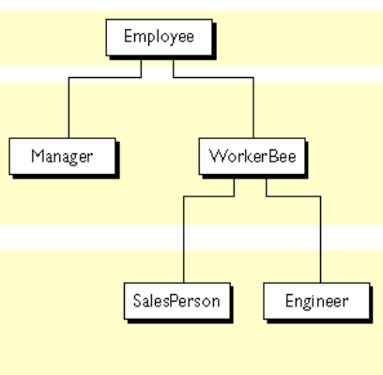
Inheritance
Access modifiers again
protected breaks encapsulation?
Constructors
hierarchy in inheritance
Notes:
Exemplu pe poza

Slide 107
Inheritance
Access modifiers again
protected breaks encapsulation?
Constructors
hierarchy in inheritance
base keyword
Notes:
Base keyword
Este folosit atunci cand vrem sa accesam membri din clasa de baza

Slide 108
Inheritance
public class Employee
{
private string name;
public Employee(string name)
{
this.name = name;
}
public virtual double GetSallary()
{
return 1500;
}
}
public class WorkerBee : Employee
{
public WorkerBee(string name) : base(name)
{
}
public override double GetSallary()
{
var defaultSallary = base.GetSallary();
return defaultSallary * 1.5;
}
}

Slide 109
Inheritance
Access modifiers again
protected breaks encapsulation?
Constructors
hierarchy in inheritance
base keyword
Upcasting & Downcasting
where does the name come from
Notes:
Casting knowledge first

Slide 110
UPCasting
public class Shape
{
protected int xpos;
protected int ypos;
public Shape()
{
}
public Shape(int x, int y)
{
xpos = x;
ypos = y;
}
public virtual void Draw()
{
Console.WriteLine(
"Drawing a SHAPE at {0},{1}",
xpos, ypos);
}
}
public class Circle : Shape
{
public Circle()
{
}
public Circle(int x, int y) : base(x, y)
{
}
public override void Draw()
{
Console.WriteLine("Drawing a CIRCLE at {0},{1}", xpos, ypos);
}
}

Slide 111
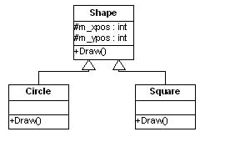
Upcasting
Shape shape = new Circle(100, 100);

Slide 112
downcasting
public class Shape
{
protected int xpos;
protected int ypos;
public Shape()
{
}
public Shape(int x, int y)
{
xpos = x;
ypos = y;
}
public virtual void Draw()
{
Console.WriteLine(
"Drawing a SHAPE at {0},{1}",
xpos, ypos);
}
}
public class Circle : Shape
{
public Circle()
{
}
public Circle(int x, int y) : base(x, y)
{
}
public void FillCircle ()
{
Console.WriteLine(“Filling the CIRCLE at {0},{1}", xpos, ypos);
}
public override void Draw()
{
Console.WriteLine("Drawing a CIRCLE at {0},{1}", xpos, ypos);
}
}

Slide 113
Downcasting
Shape shape = new Circle(100, 100);
shape.FillCircle(); // throws compilation error
Circle circle = (Circle) shape;
circle.FillCircle();
Notes:
Downcasting-ul e riscant si trebuie sa avem mereu grija cand il folosim, deoarece e explicit si e posibil ca nu mereu sa se comporte asa cum ne asteptam.

Slide 114
Inheritance
Access modifiers again
protected breaks encapsulation?
Constructors
hierarchy in inheritance
base keyword
Upcasting & Downcasting
where does the name come from
“is” keyword
“as” keyword
Notes:
Acum ca stim ce-s alea Upcasting si Downcasting, putem sa aducem vorba si de is si as

Slide 115
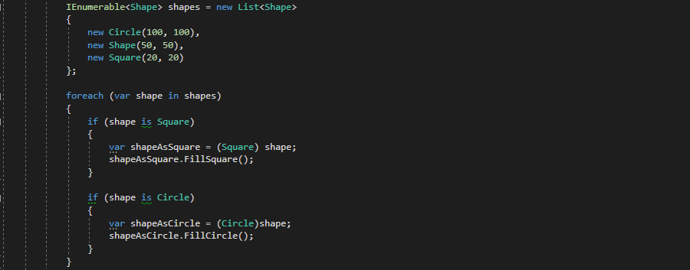
Casting (“is“ keyword)
Notes:
Is
Verifica la runtime daca un obiect este compatibil cu un tip dat. Efectiv verifica daca obiectul nostru poate fi convertit la tipul dat

Slide 116
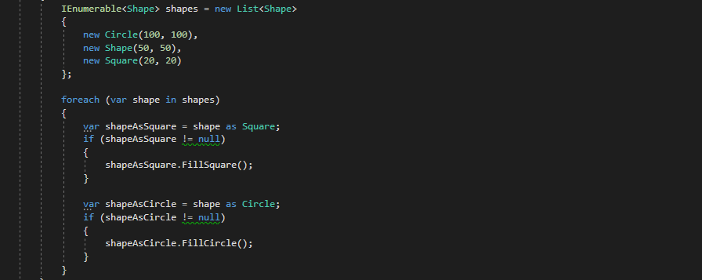
Casting(“AS” KeYWORD)
Notes:
As
Este folosit pentru conversii pentru reference type-uri compatibile intre ele. Este de fapt o operatie de cast care returneaza null atunci cand conversia nu este posibila.

Slide 117
Inheritance
Access modifiers again
protected breaks encapsulation?
Constructors
hierarchy in inheritance
base keyword
Upcasting & Downcasting
where does the name come from
“is” keyword
“as” keyword
Boxing & Unboxing
value & reference types
Notes:
Boxing & Unboxing
Ca sa putem vorbi mai departe de asta, trebuie intai sa intelegem conceptele de value & reference type
In C# nu exista pointeri, adica nu ne putem noi folosi de ei, dar exista aceste 2 tipuri pentru a putea face diferenta intre variabilele care retin si adresa de memorie sau numai valoarea efectiva.

Slide 118
Value types
The value types consist of two main categories
structs
enumerations
Structs fall into these categories
numeric types
integral types
floating-point types
decimal
bool
user defined structs.
Notes:
Value types, definitie si enumeratie luate de pe documentatia oficiala.
Value type-urile pot fi structure sau enumeratii
Structurile pot fi numerice, boolene sau definite de utilizator

Slide 119
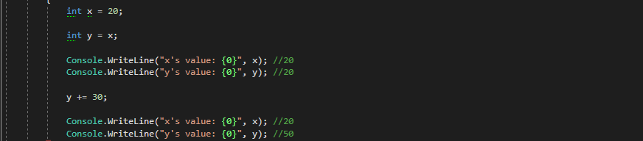
Value types
value types directly contain values
assigning leads to creating a copy
Notes:
Exemplu cod
Ce e important sa retinem ?

Slide 120
Reference Types
The following keywords are used to declare reference types:
class
interface
delegate
C# also provides the following built-in reference types:
dynamic
object
string
Notes:
Reference types
La fel ca la value types, definitie si enumeratie luate de pe documentatia oficiala

Slide 121
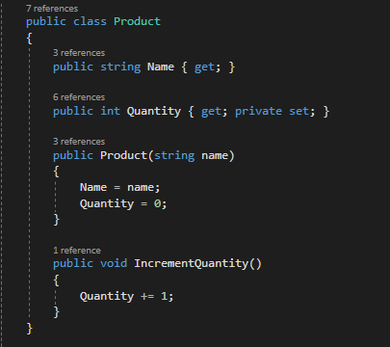
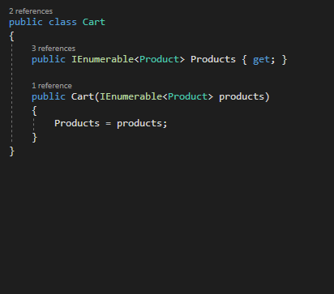
Reference types

Slide 122
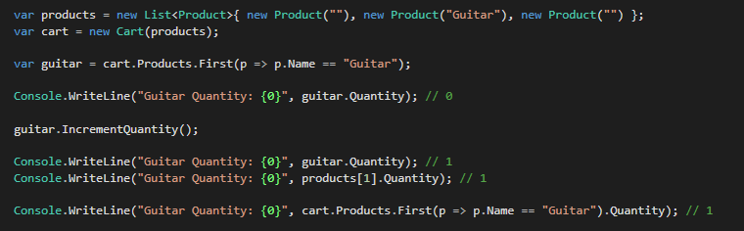
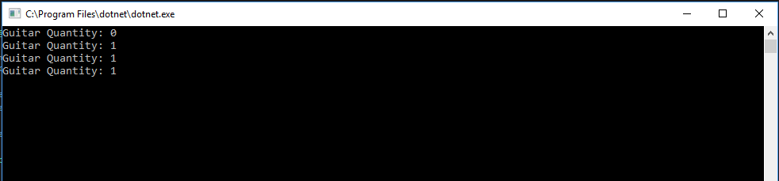
Reference types

Slide 123
Reference Types
variables of reference types store references to their data (objects)
two variables can reference the same object
operations on one variable can affect the object referenced by the other variable
Notes:
Ce trebuie sa retinem legat de reference types?

Slide 124
Inheritance
Access modifiers again
protected breaks encapsulation?
Constructors
hierarchy in inheritance
base keyword
Upcasting & Downcasting
where does the name come from
“is” keyword
“as” keyword
Boxing & Unboxing
value & reference types
definition
Notes:
Boxing = cast de la value type la reference type
Unbox = cast de la reference type la value type

Slide 125
Boxing
converting a value type to a reference type
Notes:
Boxing:
Se creeaza o copie a valorii lui i, care se pune pe heap, iar obiectul o de pe stack referentiaza spre acea copie din heap

Slide 126
UNBoxing
converting a reference type to a value type

Slide 127
Inheritance
Access modifiers again
protected breaks encapsulation?
Constructors
hierarchy in inheritance
base keyword
Upcasting & Downcasting
where does the name come from
“is” keyword
“as” keyword
Boxing & Unboxing
value & reference types
definition
why?
Notes:
Ok si totusi, de ce vrem sa facem asta?

Slide 128
Boxing & Unboxing
Boxing
store value types in the garbage-collected heap
to have unique representations of data
achieves polymorphism
Unboxing
native types performance
Notes:
In principiu nu prea vrei neaparat sa faci asta, o faci incostient, dar trebuie sa iti dai seama ca aceste lucruri se intampla si e clar ca vrei control asupra lor.
Boxing
Store bla bla
Unique representations -> boxing the same value type 3 times leads to 3 different references

Slide 129
Inheritance
Access modifiers again
protected breaks encapsulation?
Constructors
hierarchy in inheritance
base keyword
Upcasting & Downcasting
where does the name come from
“is” keyword
“as” keyword
Boxing & Unboxing
value & reference types
definition
why?
generic lists vs ArrayList
Notes:
De ce au aparut listele generice si de ce au inlocuit arraylist-ul?

Slide 130
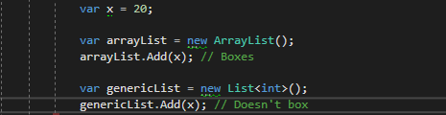
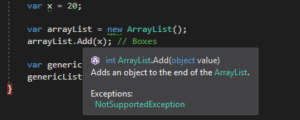
Generic lists vs arraylist
Notes:
Istoric ArrayList

Slide 131
Polymorphism
What?
the ability to change behavior at runtime
How?
inheritance
overriding
casting
interfaces
Why?
simpler code
reduced complexity
less code
Notes:
Cel mai complex principiu
Polimorfism = mai multe forme
Real life example : Mobile phone – calls, games, takes pictures, etc..
Cum?
De ce?
Cod simplu
Complexitate redusa
Mai putin cod
De exemplu, pentru o metoda care stie sa adune 2 inturi, pot crea o supraincarcare care sa stie sa adune 2 floaturi. Asa nu trebuie sa am AddInt sau AddFloat, ci cel care imi utilizeaza codul trebuie sa tine minte ca exista doar add, nu il intereseaza prea multe detalii

Slide 132
Polymorphism
Abstract classes
what?
classes that can be derived from, but cannot be instantiated
may contain missing implementation
when?
why?
less code
better control
abstract & override keywords
Inheritance & overriding
virtual & override & new keywords
avoiding if / else /switch with polymorphism
Sealed classes
why?
performance-enhancing?
better control
Notes:
Exemplu cod la fiecare header title

Slide 133
Interfaces
What is an interface ?

Slide 134
Interfaces
What is an interface ?
“The classic” :

Slide 135
Interfaces
What is an interface ?
“The classic” : An interface is a contract.

Slide 136
Interfaces
What is an interface ?
An interface contains definitions for a group of related functionalities.
Notes:
What can be enclosed : The data and behaviors are the members of the class or struct, and they include its methods, properties, and events, and so on.
Custom type : fields -> any type , including nested class

Slide 137
Interfaces
Why interface?
Notes:
Theoretically you can override them from a higher base class, but essentially an interface allows you to add on only the things you need into a class without the need for inheritance.
Consequently, because you can usually only inherit from one abstract class (in most statically typed OO languages that is... exceptions include C++) but be able to implement multiple interfaces, it allows you to construct objects in a strictly as required basis.
If you really need the inheritance , the base class can always implement the interface

Slide 138
Interfaces
Why interface?
An interface allows you to add on only the things you need into a class without the need for inheritance.
Notes:
Theoretically you can override them from a higher base class, but essentially an interface allows you to add on only the things you need into a class without the need for inheritance.
Consequently, because you can usually only inherit from one abstract class (in most statically typed OO languages that is... exceptions include C++) but be able to implement multiple interfaces, it allows you to construct objects in a strictly as required basis.
If you really need the inheritance , the base class can always implement the interface
By using interfaces, you can include behavior from multiple sources in a class. That capability is important in C# because the language doesn't support multiple inheritance of classes.

Slide 139
Interfaces
Members
An interface can contain :
Methods
Notes:
Theoretically you can override them from a higher base class, but essentially an interface allows you to add on only the things you need into a class without the need for inheritance.
Consequently, because you can usually only inherit from one abstract class (in most statically typed OO languages that is... exceptions include C++) but be able to implement multiple interfaces, it allows you to construct objects in a strictly as required basis.
If you really need the inheritance , the base class can always implement the interface

Slide 140
Interfaces
Members
An interface can contain :
Methods
Properties
Notes:
Theoretically you can override them from a higher base class, but essentially an interface allows you to add on only the things you need into a class without the need for inheritance.
Consequently, because you can usually only inherit from one abstract class (in most statically typed OO languages that is... exceptions include C++) but be able to implement multiple interfaces, it allows you to construct objects in a strictly as required basis.
If you really need the inheritance , the base class can always implement the interface

Slide 141
Interfaces
Members
An interface can contain :
Methods
Properties
Events
Notes:
Theoretically you can override them from a higher base class, but essentially an interface allows you to add on only the things you need into a class without the need for inheritance.
Consequently, because you can usually only inherit from one abstract class (in most statically typed OO languages that is... exceptions include C++) but be able to implement multiple interfaces, it allows you to construct objects in a strictly as required basis.
If you really need the inheritance , the base class can always implement the interface

Slide 142
Interfaces
Members
An interface can contain :
Methods
Properties
Events
Indexers
Notes:
Theoretically you can override them from a higher base class, but essentially an interface allows you to add on only the things you need into a class without the need for inheritance.
Consequently, because you can usually only inherit from one abstract class (in most statically typed OO languages that is... exceptions include C++) but be able to implement multiple interfaces, it allows you to construct objects in a strictly as required basis.
If you really need the inheritance , the base class can always implement the interface

Slide 143
Interfaces
Members
An interface can contain :
Methods
Properties
Events
Indexers
An interface can NOT contain :
Notes:
Theoretically you can override them from a higher base class, but essentially an interface allows you to add on only the things you need into a class without the need for inheritance.
Consequently, because you can usually only inherit from one abstract class (in most statically typed OO languages that is... exceptions include C++) but be able to implement multiple interfaces, it allows you to construct objects in a strictly as required basis.
If you really need the inheritance , the base class can always implement the interface

Slide 144
Interfaces
Members
An interface can contain :
Methods
Properties
Events
Indexers
An interface can NOT contain :
Constants
Notes:
Theoretically you can override them from a higher base class, but essentially an interface allows you to add on only the things you need into a class without the need for inheritance.
Consequently, because you can usually only inherit from one abstract class (in most statically typed OO languages that is... exceptions include C++) but be able to implement multiple interfaces, it allows you to construct objects in a strictly as required basis.
If you really need the inheritance , the base class can always implement the interface

Slide 145
Interfaces
Members
An interface can contain :
Methods
Properties
Events
Indexers
An interface can NOT contain :
Constants
Fields
Notes:
Theoretically you can override them from a higher base class, but essentially an interface allows you to add on only the things you need into a class without the need for inheritance.
Consequently, because you can usually only inherit from one abstract class (in most statically typed OO languages that is... exceptions include C++) but be able to implement multiple interfaces, it allows you to construct objects in a strictly as required basis.
If you really need the inheritance , the base class can always implement the interface

Slide 146
Interfaces
Members
An interface can contain :
Methods
Properties
Events
Indexers
An interface can NOT contain :
Constants
Fields
Operators
Notes:
Theoretically you can override them from a higher base class, but essentially an interface allows you to add on only the things you need into a class without the need for inheritance.
Consequently, because you can usually only inherit from one abstract class (in most statically typed OO languages that is... exceptions include C++) but be able to implement multiple interfaces, it allows you to construct objects in a strictly as required basis.
If you really need the inheritance , the base class can always implement the interface

Slide 147
Interfaces
Members
An interface can contain :
Methods
Properties
Events
Indexers
An interface can NOT contain :
Constants
Fields
Operators
Finalizers
Notes:
Theoretically you can override them from a higher base class, but essentially an interface allows you to add on only the things you need into a class without the need for inheritance.
Consequently, because you can usually only inherit from one abstract class (in most statically typed OO languages that is... exceptions include C++) but be able to implement multiple interfaces, it allows you to construct objects in a strictly as required basis.
If you really need the inheritance , the base class can always implement the interface

Slide 148
Interfaces
Members
An interface can contain :
Methods
Properties
Events
Indexers
An interface can NOT contain :
Constants
Fields
Operators
Finalizers
Types
Notes:
When a class or struct implements an interface, the class or struct must provide an implementation for all of the members that the interface defines. The interface itself provides no functionality that a class or struct can inherit in the way that it can inherit base class functionality. However, if a base class implements an interface, any class that's derived from the base class inherits that implementation.

Slide 149
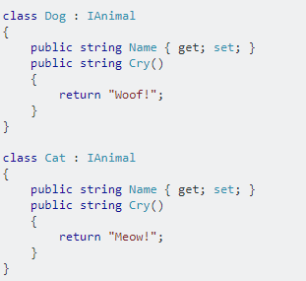
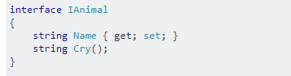
Interfaces
Notes:
When a class or struct implements an interface, the class or struct must provide an implementation for all of the members that the interface defines. The interface itself provides no functionality that a class or struct can inherit in the way that it can inherit base class functionality. However, if a base class implements an interface, any class that's derived from the base class inherits that implementation.

Slide 150
Interfaces
Interfaces and testability
Notes:
Theoretically you can override them from a higher base class, but essentially an interface allows you to add on only the things you need into a class without the need for inheritance.
Consequently, because you can usually only inherit from one abstract class (in most statically typed OO languages that is... exceptions include C++) but be able to implement multiple interfaces, it allows you to construct objects in a strictly as required basis.
If you really need the inheritance , the base class can always implement the interface

Slide 151
Interfaces
Interfaces and testability
It is very important from a development point of view to test your code.
Notes:
Less bugs, discover problems while you code , adjust the code or find a different approach that is not exposed to the possible problems that you just found.
If you really need the inheritance , the base class can always implement the interface
When you only use classes in you project, it is very difficult to test your code. That is because the test data for what you need to test is strongly dependent to the classes that you use, which can rely on other classes and so on.
Keeping things loosely coupled is essential for being able to analyze them independently from each other.

Slide 152
Interfaces
Extensibility via interfaces
Notes:
Theoretically you can override them from a higher base class, but essentially an interface allows you to add on only the things you need into a class without the need for inheritance.
Consequently, because you can usually only inherit from one abstract class (in most statically typed OO languages that is... exceptions include C++) but be able to implement multiple interfaces, it allows you to construct objects in a strictly as required basis.
If you really need the inheritance , the base class can always implement the interface

Slide 153
Interfaces
Extensibility via interfaces
One important aspect of designing a project is making sure the extensibility of the project has been carefully considered.
Notes:
Theoretically you can override them from a higher base class, but essentially an interface allows you to add on only the things you need into a class without the need for inheritance.
Consequently, because you can usually only inherit from one abstract class (in most statically typed OO languages that is... exceptions include C++) but be able to implement multiple interfaces, it allows you to construct objects in a strictly as required basis.
If you really need the inheritance , the base class can always implement the interface

Slide 154
Interfaces
Extensibility via interfaces
One important aspect of designing a project is making sure the extensibility of the project has been carefully considered.
Interfaces offer that trough Abstractions.
Notes:
Theoretically you can override them from a higher base class, but essentially an interface allows you to add on only the things you need into a class without the need for inheritance.
Consequently, because you can usually only inherit from one abstract class (in most statically typed OO languages that is... exceptions include C++) but be able to implement multiple interfaces, it allows you to construct objects in a strictly as required basis.
If you really need the inheritance , the base class can always implement the interface

Slide 155
Interfaces
Achieving polymorphism via interfaces
Notes:
Abstractions are usually implemented as abstract classes or interfaces, and they come with a well-defined set of reference documentation describing the required semantics of the types implementing the contract.
Interfaces allow you to get the benefits of polymorphism without requiring that you fit everything into one singly-inherited family of classes

Slide 156
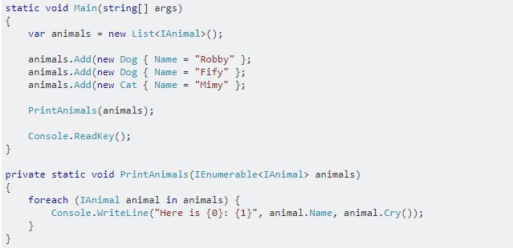
Interfaces
Achieving polymorphism via interfaces
Notes:
Abstractions are usually implemented as abstract classes or interfaces, and they come with a well-defined set of reference documentation describing the required semantics of the types implementing the contract.
It demonstrates that different types of animals can be treated the same way, but behave differently.

Slide 157
SOLID

Slide 158
SOLID
S
O
L
I
D

Slide 159
SOLID
Single Responsibility Principle
O
L
I
D

Slide 160
SOLID
Single Responsibility Principle
Open/Closed Principle
L
I
D

Slide 161
SOLID
Single Responsibility Principle
Open/Closed Principle
Liskov Substitution Principle
I
D

Slide 162
SOLID
Single Responsibility Principle
Open/Closed Principle
Liskov Substitution Principle
Interface Segregation Principle
D

Slide 163
SOLID
Single Responsibility Principle
Open/Closed Principle
Liskov Substitution Principle
Interface Segregation Principle
Dependency Inversion Principle

Slide 164
Single Responsibility Principle

Slide 165
Single Responsibility Principle
A class should have only one reason to change.
Notes:
Simplest principle to grasp and apply.
Huge reward.
This principle alone assures clean code IMO.

Slide 166
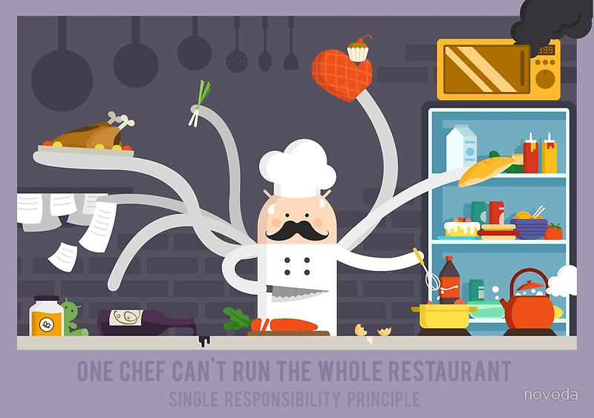
Single Responsibility Principle

Slide 167
Single responsibility - TIPS
Split big classes
Avoid god classes
Write straightforward comments

Slide 168
Open/closed principle
Notes:
Idea is that you write code for new features in new classes.
Old classes are only modified for bugfixing.
This way, you avoid breaking old functionality while writing new one.

Slide 169
Open/closed principle
Software entities should be open for extension and closed for modification.
Notes:
Idea is that you write code for new features in new classes.
Old classes are only modified for bugfixing.
This way, you avoid breaking old functionality while writing new one.

Slide 170
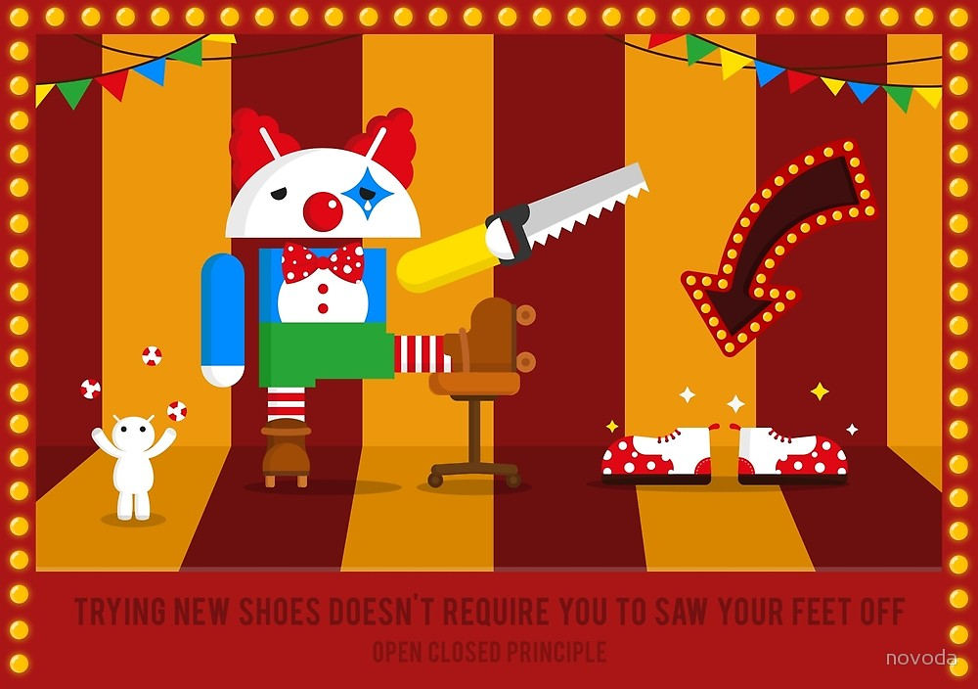
Notes:
Idea is that you write code for new features in new classes.
Old classes are only modified for bugfixing.
This way, you avoid breaking old functionality while writing new one.

Slide 171
Open/closed principle - tips
Make all members variables private
No global variables
Avoid setters (as much as possible)

Slide 172
Liskov substitution principle
Notes:
This is about Inheritance.

Slide 173
Liskov substitution principle
Subtypes must be substitutable for their base types.

Slide 174
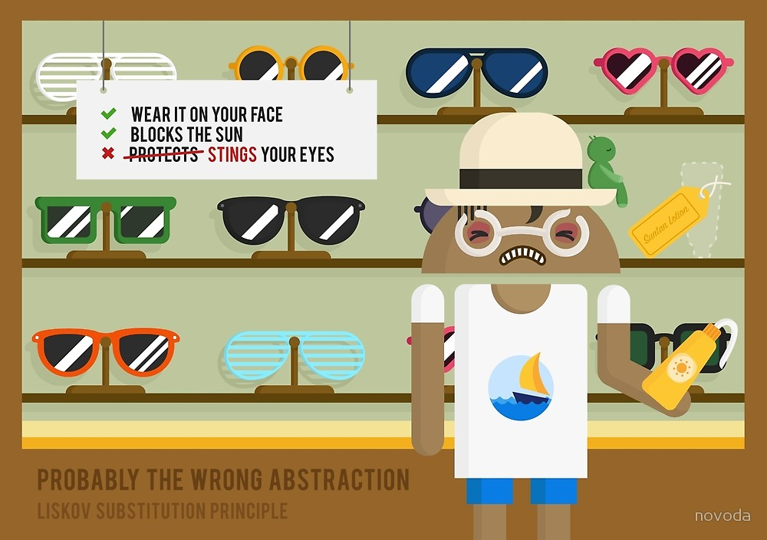

Slide 175
Liskov substitution principle - TIPS
Collapse Hierarchy
Pull Up / Push Down Field
Pull Up / Push Down Method
Be careful when using override

Slide 176
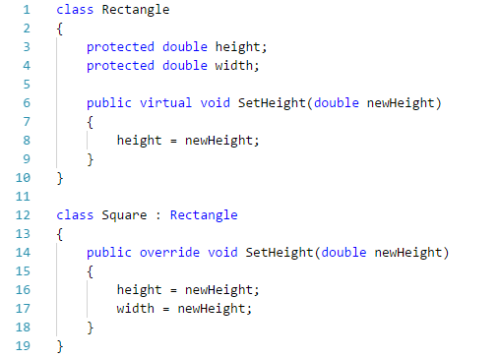
Liskov substitution principle Violation

Slide 177
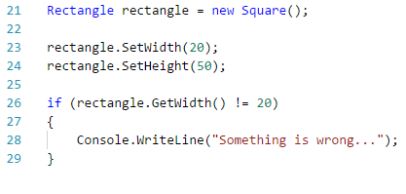
Liskov substitution principle Violation

Slide 178
Interface Segregation Principle

Slide 179
Interface Segregation Principle
Clients should not be forced to depend on methods they do not use.
Notes:
Kind of a SRP for interfaces.

Slide 180
Interface Segregation Principle
Clients should not be forced to depend on methods they do not use.
Corollary:
Prefer small interfaces to “fat” interfaces

Slide 181
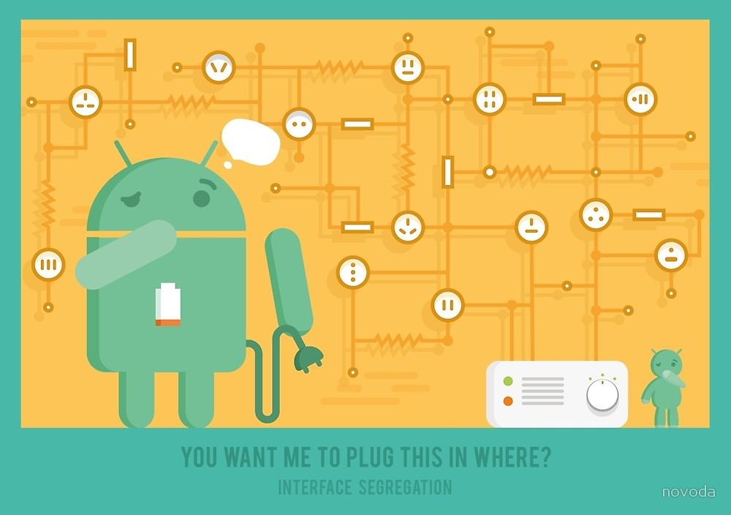

Slide 182
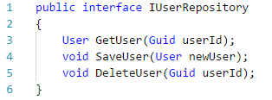
Interface Segregation Principle Violation

Slide 183
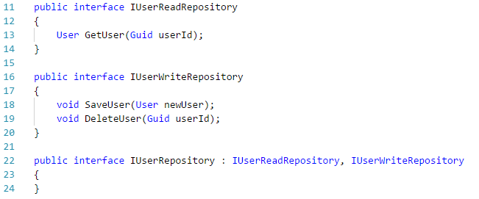
Interface Segregation Principle Fix

Slide 184
Dependency Inversion Principle

Slide 185
Dependency Inversion Principle
High-level modules should not depend on low-level modules. Both should depend on abstractions.
Notes:
This means “Use interfaces”. (Or abstract classes.)

Slide 186
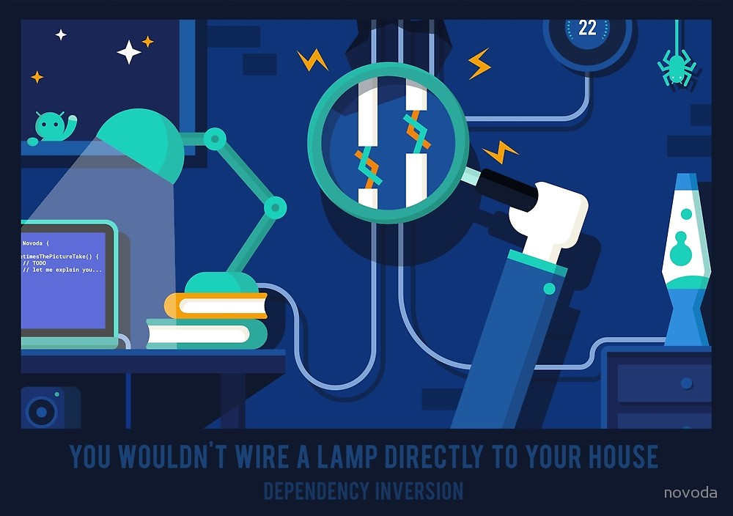
Notes:
You don’t directly interact with the wiring in your home when you plug in a lamp.
You only use an abtraction. (power socket)

Slide 187
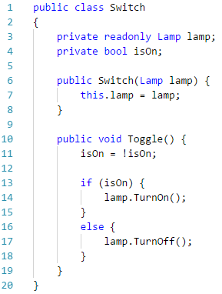
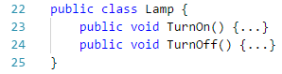
Dependency Inversion Principle Violation

Slide 188
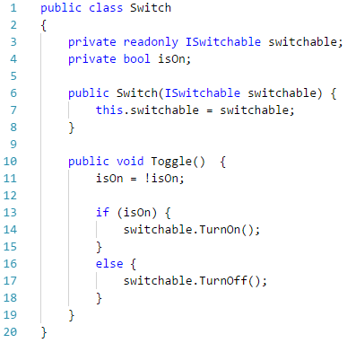
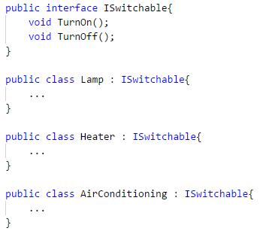
Dependency Inversion Principle Fix

Slide 189
Other principles
DRY

Slide 190
Other principles
DRY
KISS

Slide 191
Other principles
DRY
KISS
YAGNI

Slide 192
Other principles
DRY
KISS
YAGNI
SoC

Slide 193
Other principles
DRY
KISS
YAGNI
SoC
CQS

Slide 194
Other principles
DRY
KISS
YAGNI
SoC
CQS
Law Of Demeter

Slide 195
Other principles
DRY
KISS
YAGNI
SoC
CQS
Law Of Demeter
Boy scout rule

Slide 196
Other principles
DRY = Don’t Repeat Yourself

Slide 197
Other principles
DRY = Don’t Repeat Yourself
DRY principle variations :
Once and Only Once ( OOO)
Duplication Is Evil (DIE)
Notes:
The DRY principle states that every piece of knowledge must have a single, unambiguous, authoritative representation within a system.
In other words : elimination of repeatable code

Slide 198
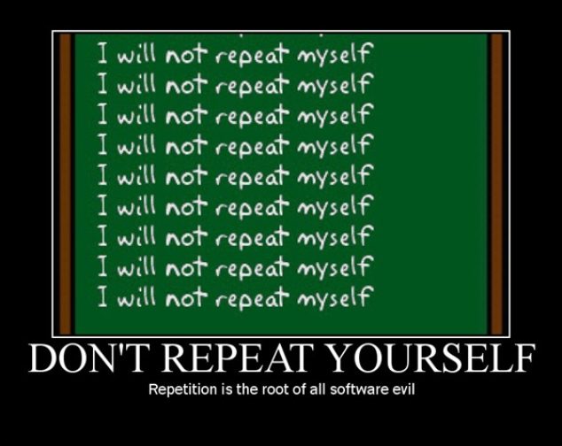
Other principles

Slide 199
Other principles
KISS = Keep It Simple, Stupid
Notes:
You should keep your system as simple as possible, because the simpler your application is, the easier it is to maintain.
In other words : elimination of repeatable code
Simplicity allows us to read and understand the source code more easily, and the ability to reason about the source code is vital for further development.

Slide 200
Other principles
KISS = Keep It Simple, Stupid
The KISS principle has two main implications:

Slide 201
Other principles
KISS = Keep It Simple, Stupid
The KISS principle has two main implications:
If you need to choose between two solutions, choose the simplest one.

Slide 202
Other principles
KISS = Keep It Simple, Stupid
The KISS principle has two main implications:
If you need to choose between two solutions, choose the simplest one.
Constantly work on simplifying your code base.

Slide 203
Other principles
KISS = Keep It Simple, Stupid
The KISS principle has two main implications:
If you need to choose between two solutions, choose the simplest one.
Constantly work on simplifying your code base.
The simpler your solution is, the better you are as a software developer.
Notes:
Most software developers can write code that works. Creating code that works and is as simple as possible – that is the true challenge.

Slide 204
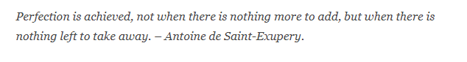
Other principles
KISS = Keep It Simple, Stupid
The KISS principle has two main implications:
If you need to choose between two solutions, choose the simplest one.
Constantly work on simplifying your code base.
The simpler your solution is, the better you are as a software developer.
Notes:
Most software developers can write code that works. Creating code that works and is as simple as possible – that is the true challenge.

Slide 205

Other principles
KISS = Keep It Simple, Stupid
Notes:
Most software developers can write code that works. Creating code that works and is as simple as possible – that is the true challenge.

Slide 206
Other principles
YAGNI = You Aren't Gonna Need It
Notes:
Most software developers can write code that works. Creating code that works and is as simple as possible – that is the true challenge.

Slide 207
Other principles
YAGNI = You Aren't Gonna Need It
You shouldn’t do anything that is not needed right now.
Notes:
because chances are you end up investing money in a feature that no one actually needs. Not only will you loose time spent on its development, but you will also increase the total cost of owning of you code base, because the more features a software contains, the more effort it takes to maintain it.

Slide 208
Other principles
YAGNI = You Aren't Gonna Need It
You shouldn’t do anything that is not needed right now.
Nothing can save you more time than not writing code.
Notes:
because chances are you end up investing money in a feature that no one actually needs. Not only will you loose time spent on its development, but you will also increase the total cost of owning of you code base, because the more features a software contains, the more effort it takes to maintain it.

Slide 209
Other principles
YAGNI = You Aren't Gonna Need It
You shouldn’t do anything that is not needed right now.
Nothing can save you more time than not writing code.
Thinking ahead is opposite to “Yagni thinking”
Laying the foundation for a functionality that we don’t need right now and might need in future almost never pays off.
Notes:
because chances are you end up investing money in a feature that no one actually needs. Not only will you loose time spent on its development, but you will also increase the total cost of owning of you code base, because the more features a software contains, the more effort it takes to maintain it.

Slide 210

Other principles
Notes:
because chances are you end up investing money in a feature that no one actually needs. Not only will you loose time spent on its development, but you will also increase the total cost of owning of you code base, because the more features a software contains, the more effort it takes to maintain it.

Slide 211
Other principles
SoC = Separation of Concerns
Notes:
Divide your application into distinct features with as little overlap in functionality as possible.
A feature or functionality can be optimized independently of other features or functionality .
If one feature fails, it will not cause other features to fail as well, and they can run independently of one another.

Slide 212
Other principles
SoC = Separation of Concerns
Using SoC you can :

Slide 213
Other principles
SoC = Separation of Concerns
Using SoC you can :
allow people to work on individual pieces of the system in isolation

Slide 214
Other principles
SoC = Separation of Concerns
Using SoC you can :
allow people to work on individual pieces of the system in isolation
facilitate reusability

Slide 215
Other principles
SoC = Separation of Concerns
Using SoC you can :
allow people to work on individual pieces of the system in isolation
facilitate reusability
ensure the maintainability of a system

Slide 216
Other principles
SoC = Separation of Concerns
Using SoC you can :
allow people to work on individual pieces of the system in isolation
facilitate reusability
ensure the maintainability of a system
add new features easily

Slide 217
Other principles

Slide 218
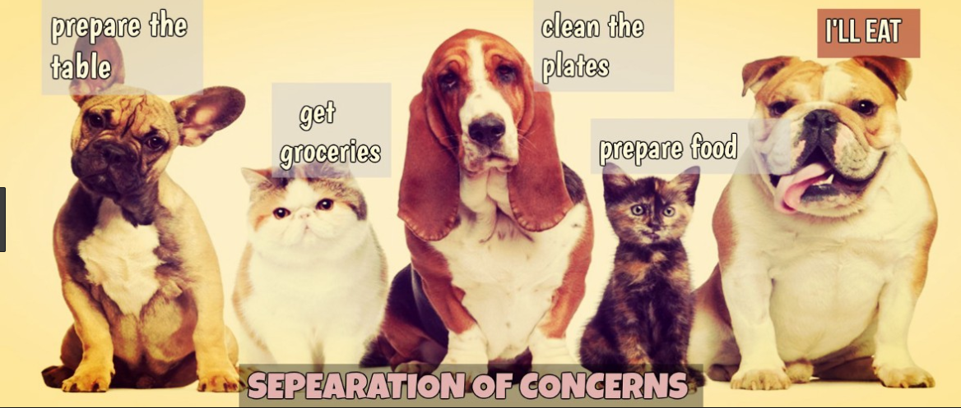
Other principles

Slide 219
Other principles
CQS = Command Query Separation

Slide 220
Other principles
CQS = Command Query Separation
The fundamental idea is that we should divide an object's methods into two sharply separated categories:

Slide 221
Other principles
CQS = Command Query Separation
The fundamental idea is that we should divide an object's methods into two sharply separated categories:
Queries: Return a result and do not change the observable state of the system (are free of side effects).

Slide 222
Other principles
CQS = Command Query Separation
The fundamental idea is that we should divide an object's methods into two sharply separated categories:
Queries: Return a result and do not change the observable state of the system (are free of side effects).
Commands: Change the state of a system but do not return a value.

Slide 223
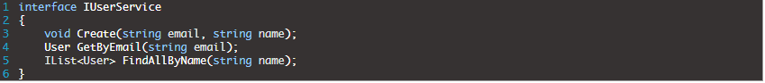
Other principles
CQS = Command Query Separation
Notes:
As we can see, the method Create() does not return any value. Its only job is to create a new user account (and probably perform some validation first etc.). The important part here is that we are certain that this action has some kind of “side effects” (new user account will be created), so it does mutate the state.
On the other hand, both the GetByEmail() and FindAllByName() functions, do not have any kind of “side effects” (do not mutate the state). These actions (queries) are responsible only for fetching the users from some data storage. It means that we can execute them N number of times, and we will always get the same results.

Slide 224
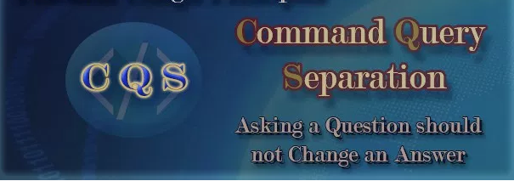
Other principles
CQS = Command Query Separation
Notes:
As we can see, the method Create() does not return any value. Its only job is to create a new user account (and probably perform some validation first etc.). The important part here is that we are certain that this action has some kind of “side effects” (new user account will be created), so it does mutate the state.
On the other hand, both the GetByEmail() and FindAllByName() functions, do not have any kind of “side effects” (do not mutate the state). These actions (queries) are responsible only for fetching the users from some data storage. It means that we can execute them N number of times, and we will always get the same results.

Slide 225
Other principles
Law of Demeter
Notes:
Each unit should have only limited knowledge about other units: only units “closely” related to the current unit. Each unit should only talk to its friends; don’t talk to strangers.
The main purpose of this law is to restrict outside objects being able to access the internals of another object. Accessing internals encounters problems:
It might give information about the internal structure of the object

Slide 226
Other principles
Law of Demeter
Each unit should have only limited knowledge about other units: only units “closely” related to the current unit. Each unit should only talk to its friends; don’t talk to strangers.

Slide 227
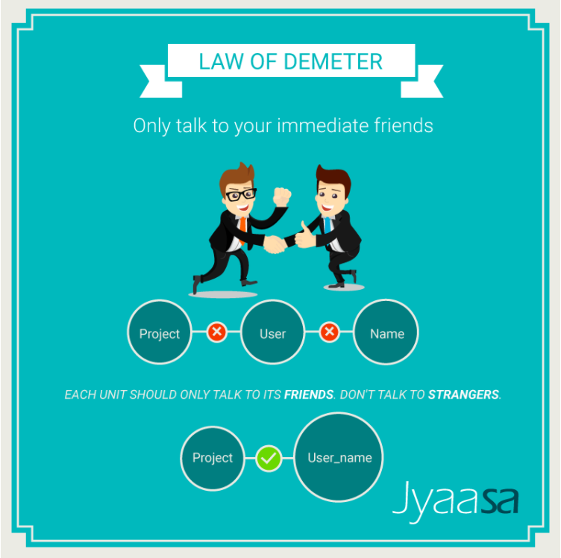
Other principles

Slide 228
Other principles
Boy scout rule

Slide 229
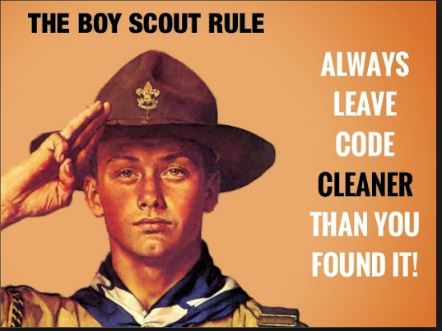
Other principles
Notes:
The Boy Scouts have a rule: "Always leave the campground cleaner than you found it." If you find a mess on the ground, you clean it up regardless of who might have made the mess. You intentionally improve the environment for the next group of campers. Actually the original form of that rule, written by Robert Stephenson Smyth Baden-Powell, the father of scouting, was "Try and leave this world a little better than you found it."
What if we followed a similar rule in our code: "Always check a module in cleaner than when you checked it out." No matter who the original author was, what if we always made some effort, no matter how small, to improve the module. What would be the result?
I think if we all followed that simple rule, we'd see the end of the relentless deterioration of our software systems. Instead, our systems would gradually get better and better as they evolved. We'd also see teams caring for the system as a whole, rather than just individuals caring for their own small little part.
I don't think this rule is too much to ask. You don't have to make every module perfect before you check it in. You simply have to make it a little bit better than when you checked it out. Of course, this means that any code you add to a module must be clean. It also means that you clean up at least one other thing before you check the module back in. You might simply improve the name of one variable, or split one long function into two smaller functions. You might break a circular dependency, or add an interface to decouple policy from detail.
Frankly, this just sounds like common decency to me — like washing your hands after you use the restroom, or putting your trash in the bin instead of dropping it on the floor. Indeed the act of leaving a mess in the code should be as socially unacceptable as littering. It should be something that just isn't done.
But it's more than that. Caring for our own code is one thing. Caring for the team's code is quite another. Teams help each other, and clean up after each other. They follow the Boy Scout rule because it's good for everyone, not just good for themselves.
by Uncle Bob

Slide 230
Conclusion
Notes:
The Boy Scouts have a rule: "Always leave the campground cleaner than you found it." If you find a mess on the ground, you clean it up regardless of who might have made the mess. You intentionally improve the environment for the next group of campers. Actually the original form of that rule, written by Robert Stephenson Smyth Baden-Powell, the father of scouting, was "Try and leave this world a little better than you found it."
What if we followed a similar rule in our code: "Always check a module in cleaner than when you checked it out." No matter who the original author was, what if we always made some effort, no matter how small, to improve the module. What would be the result?
I think if we all followed that simple rule, we'd see the end of the relentless deterioration of our software systems. Instead, our systems would gradually get better and better as they evolved. We'd also see teams caring for the system as a whole, rather than just individuals caring for their own small little part.
I don't think this rule is too much to ask. You don't have to make every module perfect before you check it in. You simply have to make it a little bit better than when you checked it out. Of course, this means that any code you add to a module must be clean. It also means that you clean up at least one other thing before you check the module back in. You might simply improve the name of one variable, or split one long function into two smaller functions. You might break a circular dependency, or add an interface to decouple policy from detail.
Frankly, this just sounds like common decency to me — like washing your hands after you use the restroom, or putting your trash in the bin instead of dropping it on the floor. Indeed the act of leaving a mess in the code should be as socially unacceptable as littering. It should be something that just isn't done.
But it's more than that. Caring for our own code is one thing. Caring for the team's code is quite another. Teams help each other, and clean up after each other. They follow the Boy Scout rule because it's good for everyone, not just good for themselves.
by Uncle Bob

Slide 231
Questions?
Andrei Apetrei
andrei.apetrei@centric.eu
Răzvan Rădeanu
razvan.radeanu@centric.eu
Radu Șolcă
radu.solca@centric.eu

Slide 232


